Slide 1
ECE5584 Digital Image Processing: Final Project Image Restoration with Deep Learning Fall 2019
By Matthew Kayrish and Maiyue Zhang

Slide 2
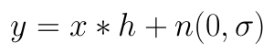
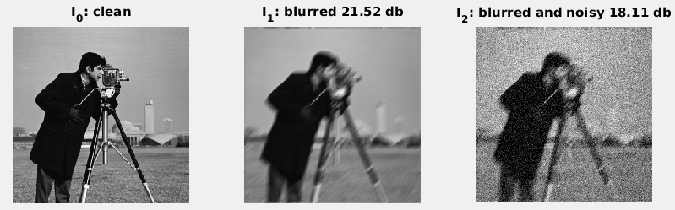
Final Project: Introduction
“Based on the solutions from HW-4, we will study two problems in deep learning based image restoration/denoising. Consider an image corrupted by both a PSF (blur in this case) and additive noises:
“Where x is the clean image, h is the point spread function (PSF) that creates input dependent corruptions, and n is the additive Gaussian noise. An example is illustrated below, with I₁ being blurred with angle 45o length 11 motion blur, and I₂ blurred with the same motion blur with additive noise with variance 0.004;
To have a fair comparison, we utilize VDSR like residual learning network with fixed depth of 4 blocks of [CONV(64 x 3 x 3) + ReLU] operations, while focusing on the research problems…”

Slide 3
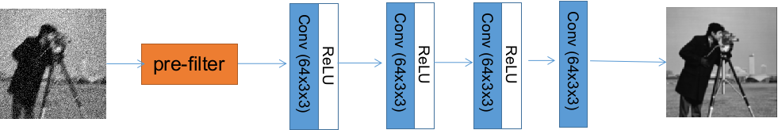
Final Project: Part 1 Introduction
“To have a fair comparison, we utilize VDSR like residual learning network with fixed depth of 4 blocks of [CONV(64 x 3 x 3) + ReLU] operations, while focusing on the research problems of,
Input noisy image pre-filtering [20 pts]:
Develop pre-filtering schemes on the input, before training for the deep residual network denoising, and see if prefiltering can improve the performance. Suggested method: bilateral filtering, try a number of different range and value kernel size and analyze the results.

Slide 4
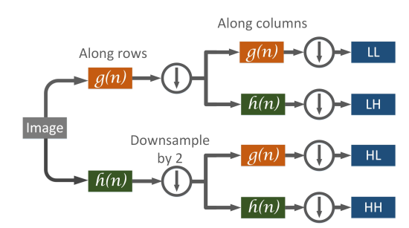
Final Project: Part 2 Introduction
“To have a fair comparison, we utilize VDSR like residual learning network with fixed depth of 4 blocks of [CONV(64 x 3 x 3) + ReLU] operations, while focusing on the research problems of,
Target image decomposition [10pts]:
To directly learn the target image is kind of difficult. Instead, the ground truth images are decomposed using wavelets into subimages of {LL, LH, HL, and HH} bands:
Use the same 4-block residual learning framework to learn these sub-images from noisy input, and report the PSNR for each subband, as well as overall re-combined images.

Slide 5
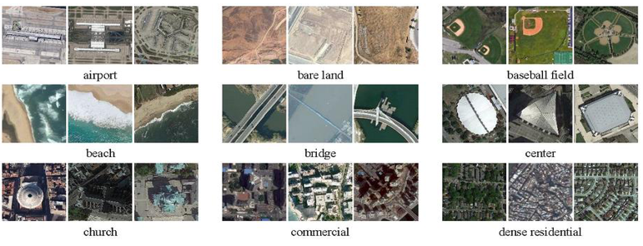
Final Project Data Set
AID data set: https://captain-whu.github.io/AID/

Slide 6
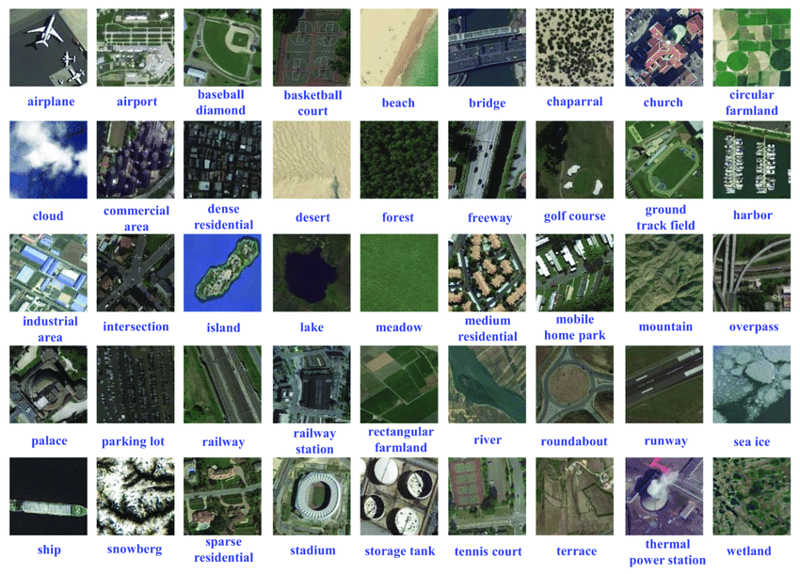
Final Project Data Set
NWPU RESISC 45: http://www.escience.cn/people/JunweiHan/NWPU-RESISC45.html

Slide 7
Final Project: Part 1
Input noisy image pre-filtering [20 pts]:
Develop pre-filtering schemes on the input, before training for the deep residual network denoising, and see if prefiltering can improve the performance. Suggested method: bilateral filtering, try a number of different range and value kernel size and analyze the results.

Slide 8
Part 1: Training Code
Files involved in Training:
trainFP.py
trainBilat.py
trainCNN.py
model.py
dataset.py
utils.py
noise_generator.py

Slide 9
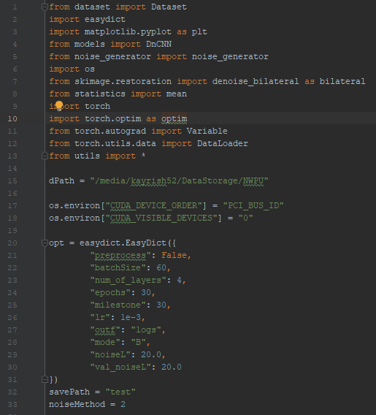
From trainBilat.py
Include the needed packages
Set the location of training data
Tell the program HOW to find the GPU
Set the training parameters

Slide 10
From trainBilat.py
Include the needed packages
Set the location of training data
Tell the program HOW to find the GPU
Set the training parameters
Depth equal 4
Sigma = 20.0…Scaled by 10

Slide 11
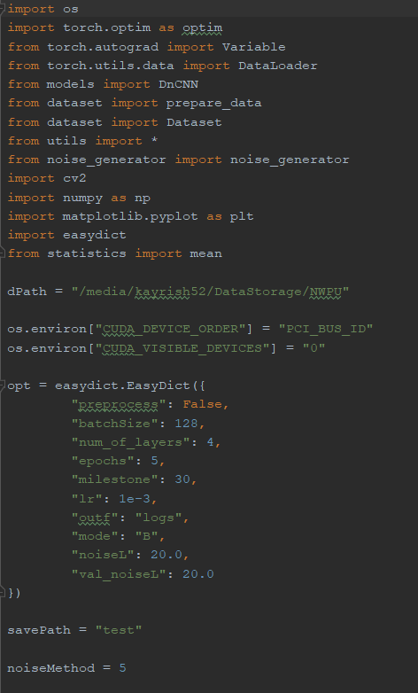
From trainBilat.py
Include the needed packages
Set the location of training data
Tell the program HOW to find the GPU
Set the training parameters
Depth equal 4 or 8 layers
Sigma = 20.0…Scaled by 10

Slide 12
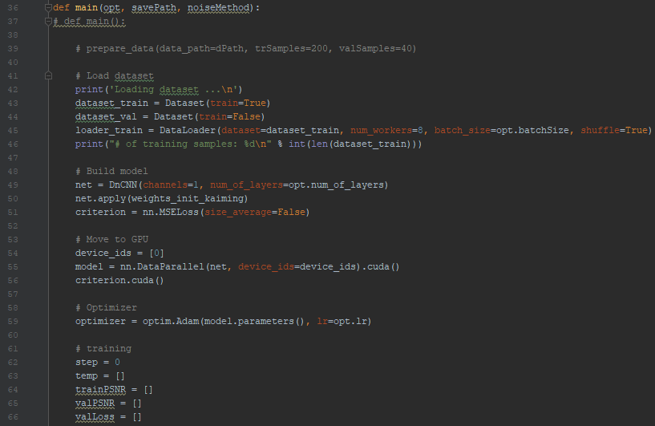
From trainBilat.py
Load the data
Set the training data
Define the model as a DuCNN with 1 channel for grayscale
Initialize the weights
Set the Loss function
Tell Python to use the GPU
Initialize the model and put it on the GPU
Set the Optimizer
Initialize variables

Slide 13
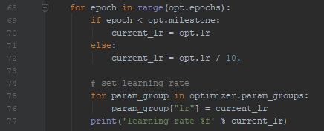
From trainBilat.py
Enter the training loop
Set the learning rate

Slide 14
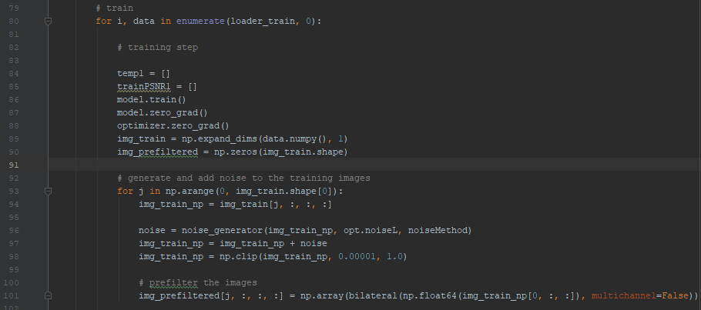
From trainBilat.py
Enter the loop for cycling the training data
Initialize Training and Tracking Parameters
Initialize training data and prefiltered training data
Enter the loop to prefilter the training data
Add noise to the image
Prefilter the image

Slide 15
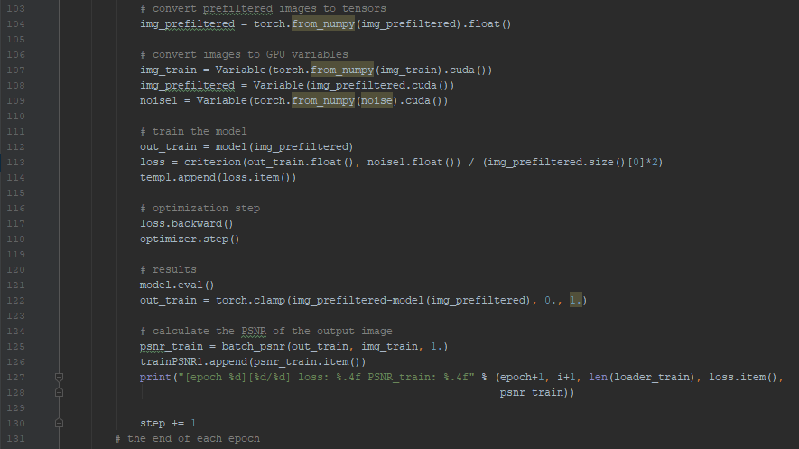
From trainBilat.py
Convert the Prefiltered images to PyTorch tensors
Move training data, prefiltered data, and noise to the GPU
Pass prefiltered data through model and calculate the loss
Perform the optimization
Calculate the residual and denoised image
Calculate the PSNR

Slide 16
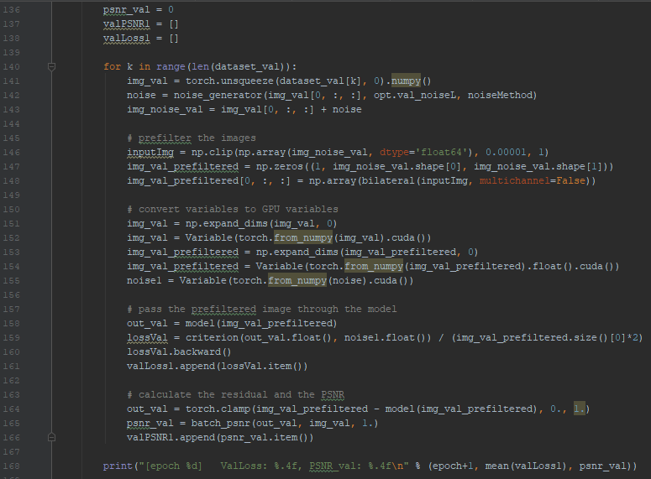
From trainBilat.py
Initialize the validation data
Loop over the validation dataset
Call noise generation
Add noise to validation snapshot
Prefilter validation data
Move to GPU
Pass data through network
Calculate loss
Calculate the PSNR
Track all of the data

Slide 17
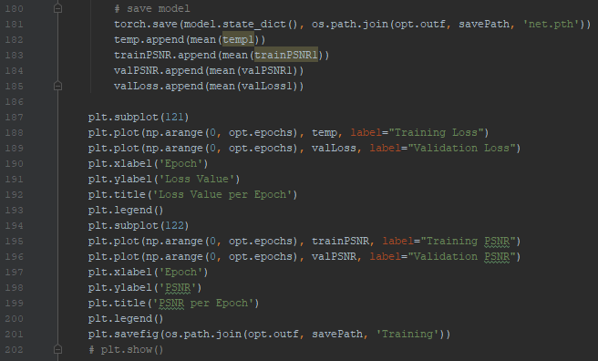
From trainBilat.py
Capture Validation Data
Plot the Training Loss and Validation Loss
Plot the PSNR for Training and Validation
Save the plots to a file

Slide 18
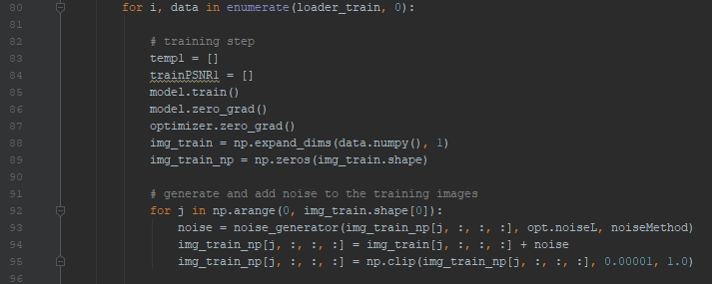
From trainCNN.py
trainCNN.py is nearly identical to trainBilat.py. The main difference is that prefiltering is not performed.
Enter the loop for cycling the training data
Initialize Training and Tracking Parameters
Initialize training data
Enter the loop to add noise to the training data
Add noise to the image

Slide 19
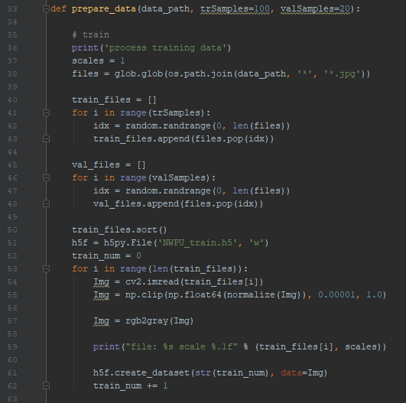
From dataset.py
dataset.py has changed from HW4. Splitting images into patches, pre-scaling, and data augmentation has been removed. Converting images to grayscale has been added. This was done to ease the burden associated with creating wavelets in part 2.
Prepare the training data
Select the training and validation data
Load the data as an image
Convert the data to grayscale
Save and close as an h5f dataset

Slide 20
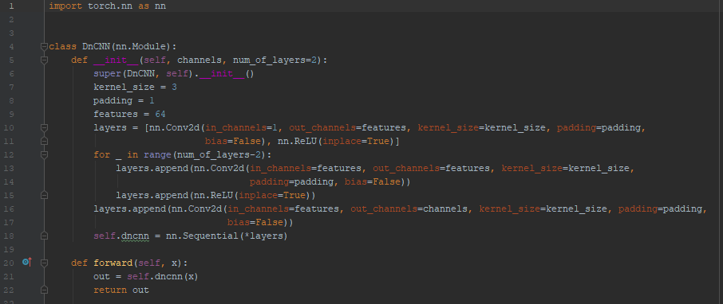
From model.py
Class Module for the Deep Learning CNN.
Set the number of channels to ‘1’ for grayscale images
Create and append convolutional layers
Create and append ReLU layers
Convert the added layers to ‘Sequential Layers’

Slide 21
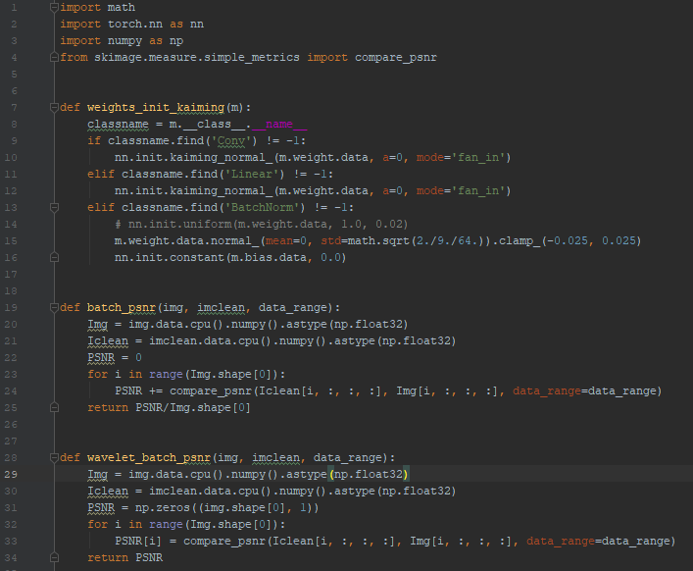
From utils.py
Import classes for image processing
Define function for initializing weights
Define a PSNR function for tensors
Define a PSNR function for wavelets

Slide 22
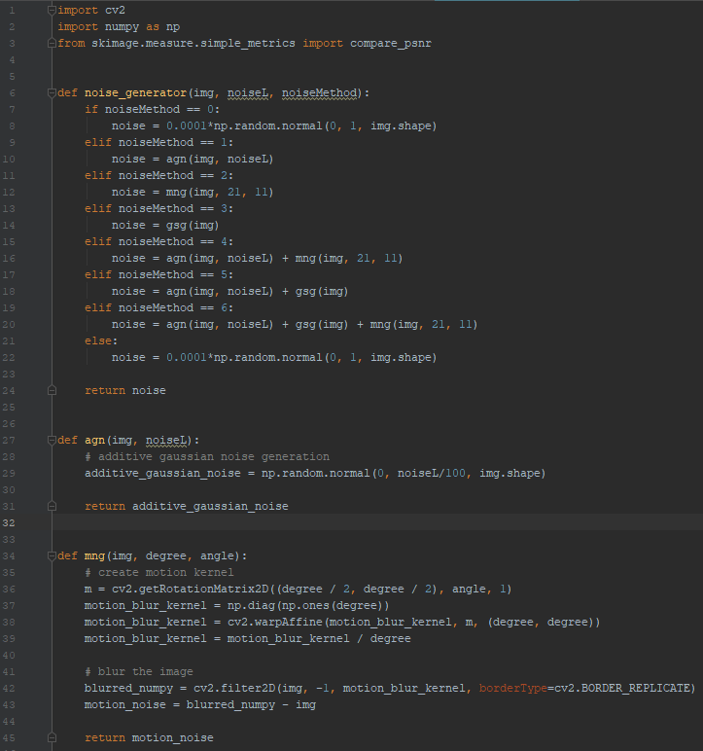
From noise_generator.py
Generate the noise method selector
Define an Additive Gaussian Noise Function
Define a Motion Noise Function

Slide 23
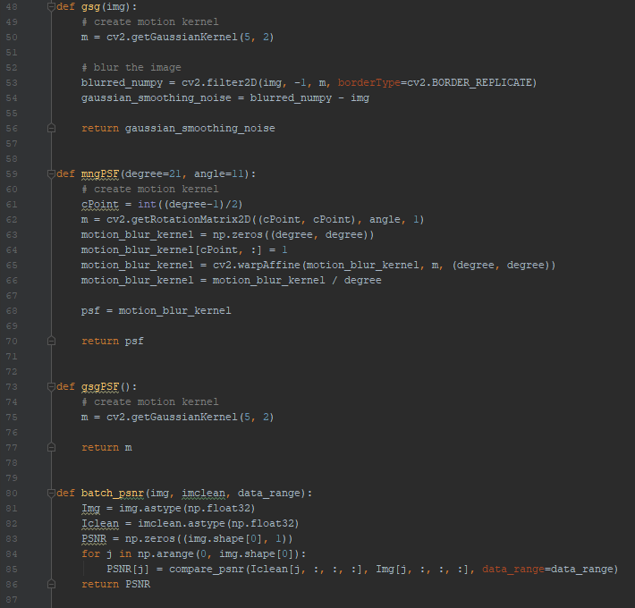
From noise_generator.py
Define a Gaussian Smoothing Function
Define a Motion Noise PSF Kernel Function
Define a Gaussian Smoothing PSF Kernel Function
Define a PSNR Function for Numpy Arrays

Slide 24
From trainCNN.py
Calculate the output residual image from the designed network

Slide 25
Final Project: Part 2
“To have a fair comparison, we utilize VDSR like residual learning network with fixed depth of 4 blocks of [CONV(64 x 3 x 3) + ReLU] operations, while focusing on the research problems of,
Target image decomposition [10pts]:
To directly learn the target image is kind of difficult. Instead, the ground truth images are decomposed using wavelets into subimages of {LL, LH, HL, and HH} bands:
Use the same 4-block residual learning framework to learn these sub-images from noisy input, and report the PSNR for each subband, as well as overall re-combined images.

Slide 26
Part 2: Training Code
Files involved in Training:
trainFP.py
trainWavelet.py
calcWavelet.py
model.py
dataset.py
utils.py
noise_generator.py

Slide 27
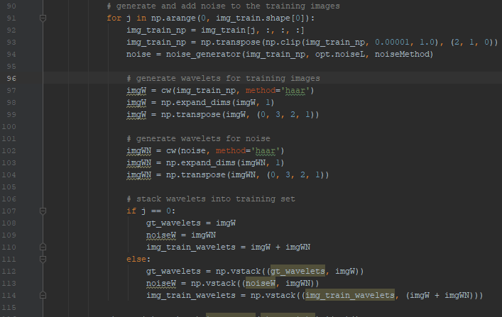
From trainWavelet.py
trainWavelet.py has many identical parts of code to trainBilat.py. The main differences are highlighted here.
Enter the loop for processing the training data
Generate Noise
Compute the wavelets for images and noise
Stack the wavelets into a larger training stack
The decision to compute the wavelets for the Ground Truth image and the noise separately, then combine after comes from the need to plot the Ground Truth, noisy image, and recovered image wavelets, and then the reconstructed images. This eased the burden of processing and enabled training, testing, and reconstruction in a shorter amount of time.

Slide 28
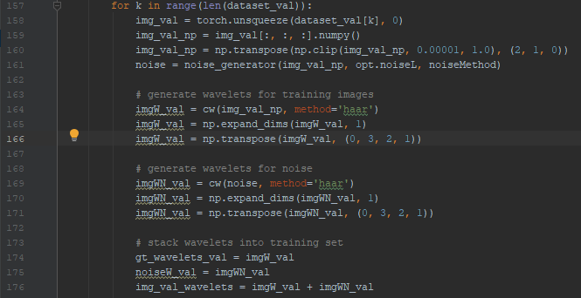
From trainWavelet.py
trainWavelet.py has many identical parts of code to trainBilat.py. The main differences are highlighted here.
Enter the loop for processing the validation data
Generate Noise
Compute the wavelets for images and noise
Stack the wavelets into a larger training stack
The decision to compute the wavelets for the Ground Truth image and the noise separately, then combine after comes from the need to plot the Ground Truth, noisy image, and recovered image wavelets, and then the reconstructed images. This eased the burden of processing and enabled training, testing, and reconstruction in a shorter amount of time.

Slide 29
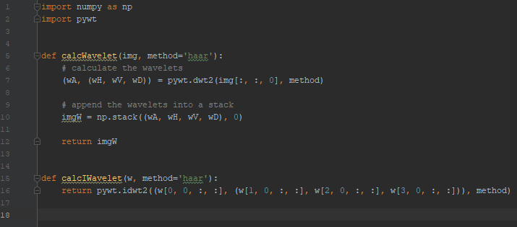
From calcWavelet.py
Import Numpy and Wavelet Libraries
Define a function for computing the wavelet transform
Define a function for computing the inverse wavelet transform

Slide 30
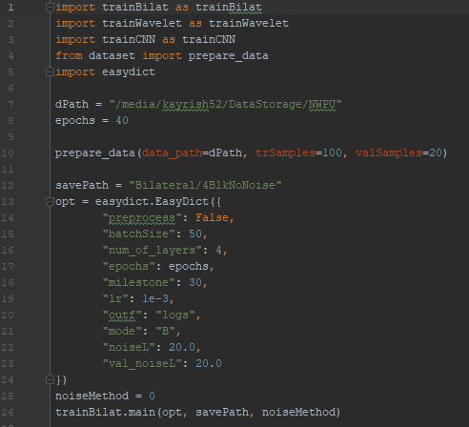
Training Various Configurations: From trainFP.py
Import various libraries, including:
trainBilat
trainWavelet
trainCNN
Set path to training data
Set number of epochs
Prepare the training and validation data
Conduct runs (18 training runs in total)
Train Parameters:
4 layers
1e-3 learning rate
40 epochs in all cases
100 training samples/20 validation samples
50 batch size on NVIDIA 2070 SUPER

Slide 31
Training Various Configurations: From trainFP.py
Noise Parameters:
No Noise
Additive Gaussian Noise Only
Motion Blurring Only
Gaussian Smoothing Only
Motion Plus Additive Gaussian
Gaussian Smoothing Plus Additive Gaussian
Networks Trained:
Wavelet Decomposition as Input
Bilateral Prefiltering as Input
Standard CNN as Input

Slide 32
Testing Code
Files involved in Testing:
testFP.py
testImage.py
calcWavelet.py
model.py
dataset.py
utils.py
noise_generator.py

Slide 33
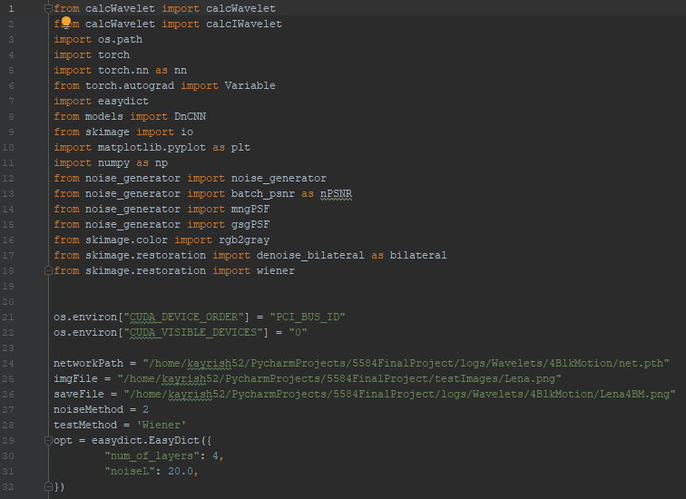
From testImage.py
Import various libraries
Tell the program HOW to find the GPU
Set the testing parameters

Slide 34
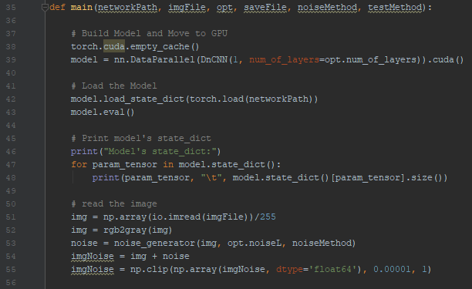
From testImage.py
Define the main function
Load the trained model
Place the model on the GPU
Read into memory the testing image
Convert the image to grayscale
Add noise

Slide 35
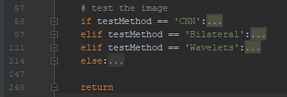
From testImage.py
This snippet of code is collapsed. Each part will be expanded and explained in the following slides.
Determine the test method
Execute code for that test method
Return from main function

Slide 36
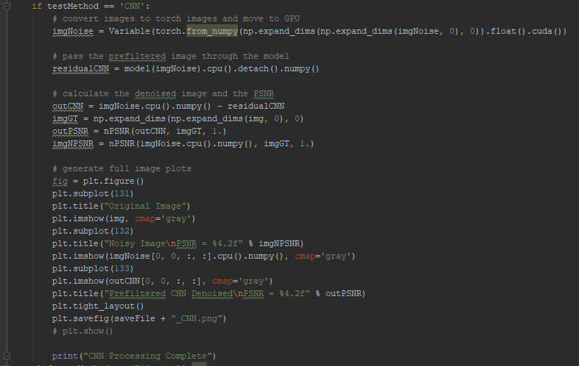
From testImage.py
Select Standard CNN Denoising
Convert Noisy Image to GPU Tensor
Calculate the residual
Subtract the noise
Calculate the PSNR of denoised image
Calculate the PSNR of the original image
Plot the Ground Truth, Noisy Image, and Denoised Image

Slide 37
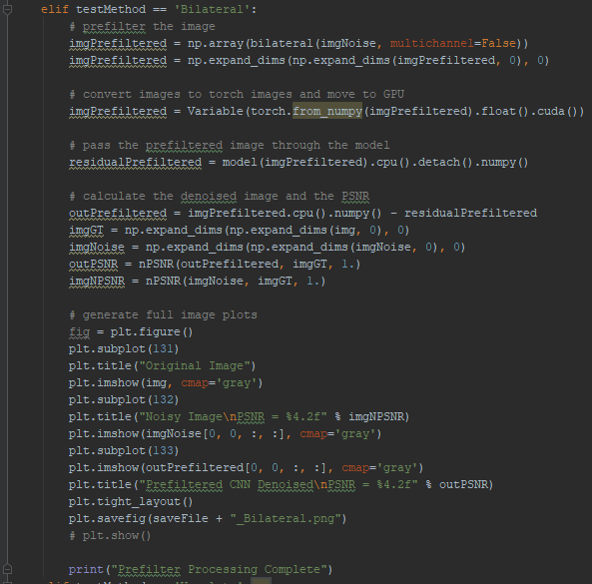
From testImage.py
Select Bilateral Prefiltering prior to CNN Denoising
Prefilter the image
Convert Noisy Image to GPU Tensor
Calculate the residual
Subtract the noise
Calculate the PSNR of original and the denoised image
Plot the Ground Truth, Noisy Image, and Denoised Image

Slide 38
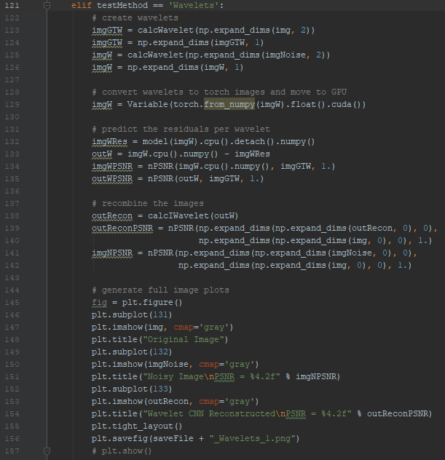
From testImage.py
Select Wavelet Decomposition prior to CNN Denoising
Calculate the wavelets
Calculate the residual of each wavelet
Calculate the denoised image
Calculate the PSNR of original and the denoised wavelets
Reconstruct from wavelets the original and denoised image
Plot the Ground Truth, Noisy, and Denoised reconstructed Image

Slide 39
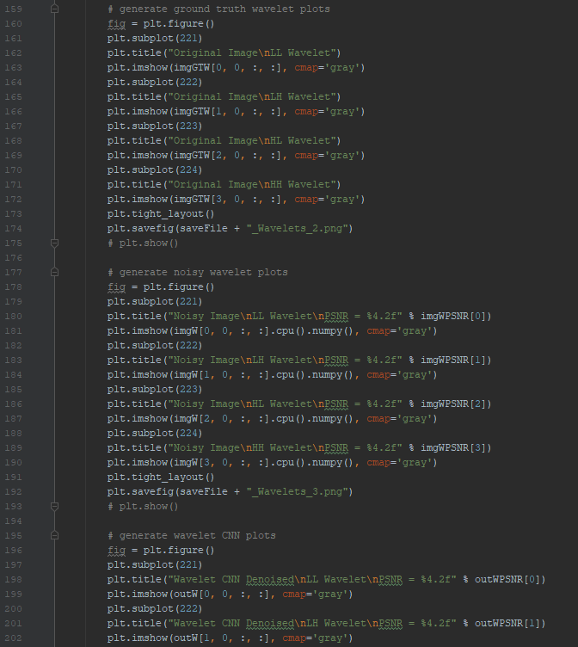
From testImage.py
Plot the original, noisy, and denoised wavelets

Slide 40
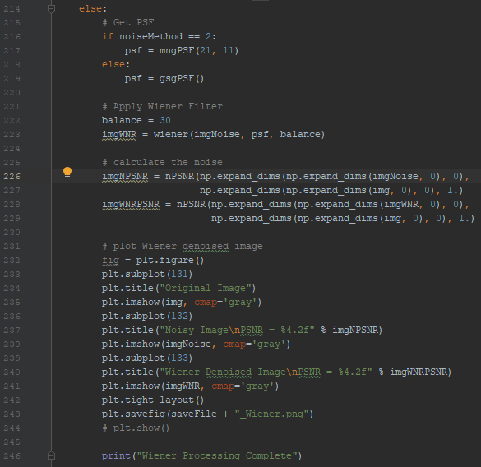
From testImage.py
Default to Wiener Filter Denoising
Select the appropriate point spread function
Apply Wiener Filtering
Calculate the PSNR of the noisy and denoised image
Plot the Ground Truth, Noisy, and Denoised reconstructed Image

Slide 41
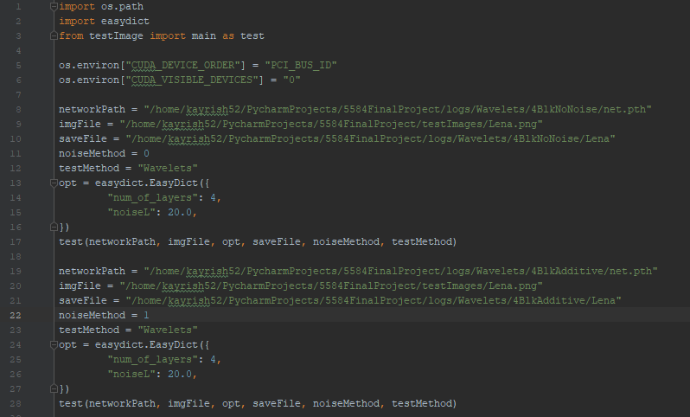
Testing Various Configurations: From testFP.py
Import various libraries
Tell Program how to find GPU
Set testing parameters
Network Path
Test File
Save File
Noise Method
Test Method
Model Parameters
Test the image
Conduct runs (48 test runs in total)

Slide 42
Testing Various Configurations: From testFP.py
Noise Parameters:
No Noise
Additive Gaussian Noise Only
Motion Blurring Only
Gaussian Smoothing Only
Motion Plus Additive Gaussian
Gaussian Smoothing Plus Additive Gaussian
Test Methods:
Wavelet Decomposition as Input
Bilateral Prefiltering as Input
Standard CNN as Input
Wiener Filtering

Slide 43
Training Parameters for Final Project
Learning Rate: 1e-3
40 epochs
Noise Parameters:
No Noise
Additive Gaussian White (AGW) Noise Only
Motion Blurring Only
Gaussian Smoothing Only
Motion Blurring Plus AGW
Gaussian Smoothing Plus AGW
Number of Training Samples: 100 Samples
Number of Convolutional Layers: 4 Blocks
Various Network Architectures Used:
Wavelet Decomposition
Bilateral Prefiltering
Standard CNN

Slide 44
Training Parameters: Noise Parameters
For Additive Gaussian White Noise
Mean: 0
Std.: 2.0
For Motion Noise/Blurring
Angle from 0: 11
Length: 21
For Gaussian Smoothing Noise
Mean: 0
Std.: 2.0

Slide 45
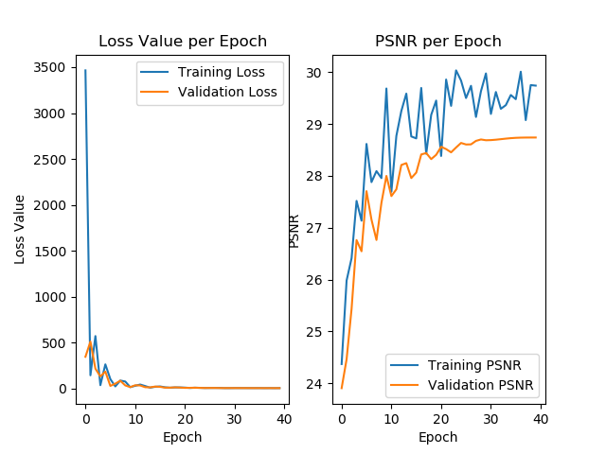
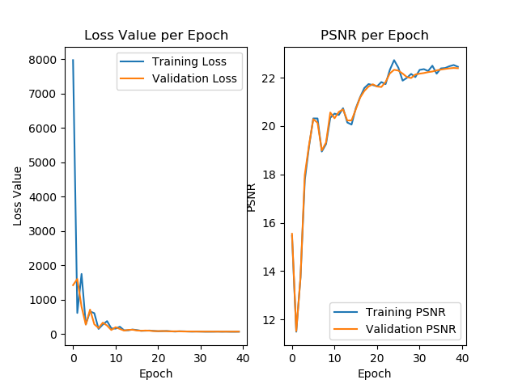
Training Results: Wavelets
No Noise
Additive Gaussian Noise

Slide 46
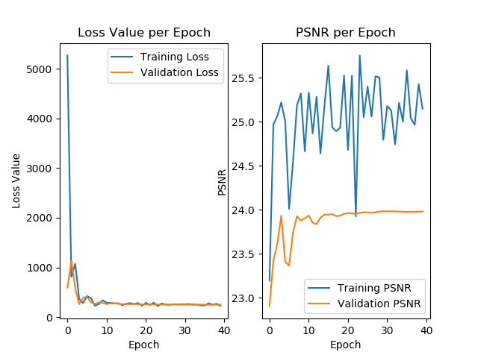
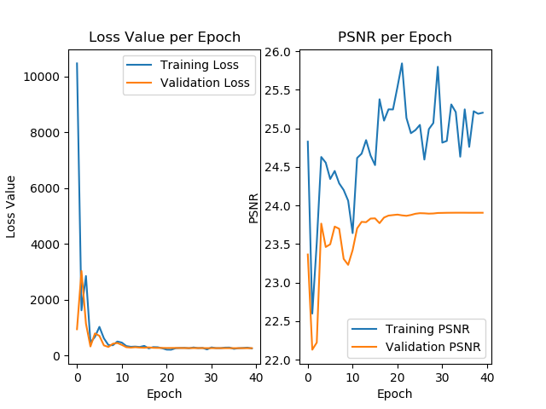
Training Results: Wavelets
Motion Noise
Smoothing Noise

Slide 47
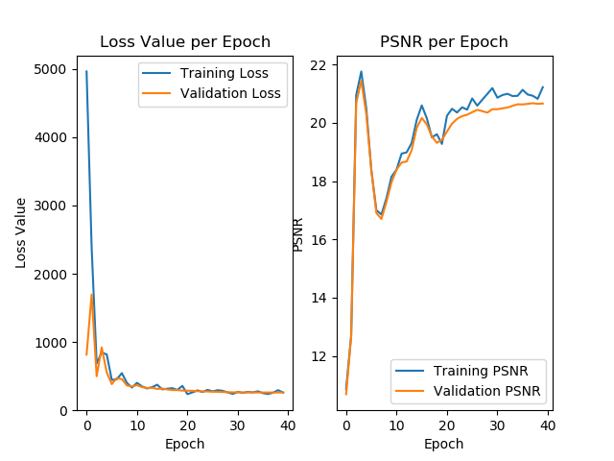
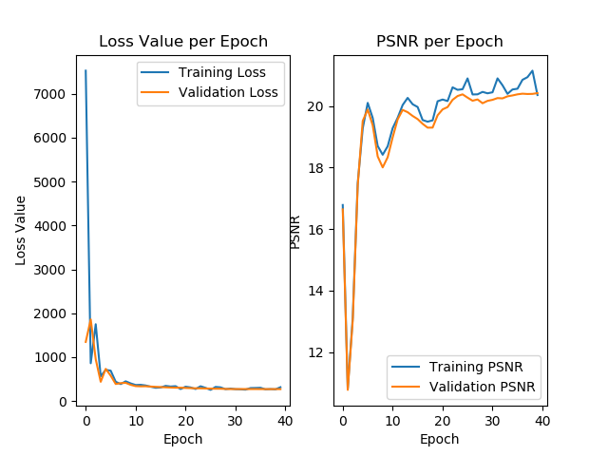
Training Results: Wavelets
Motion Plus White Noise
Smoothing Plus White Noise

Slide 48
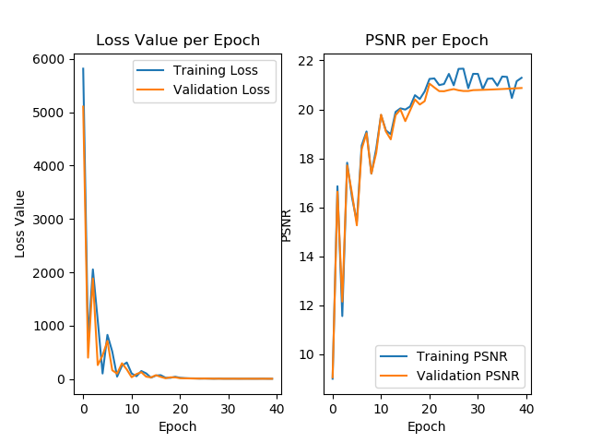
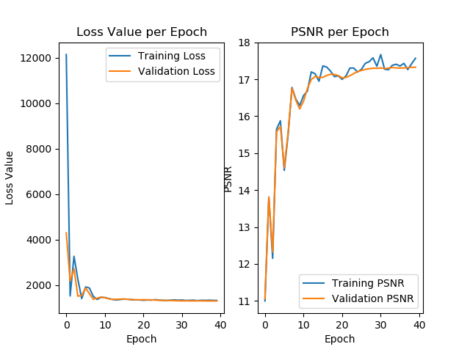
Training Results: Bilateral
No Noise
Additive Gaussian Noise

Slide 49
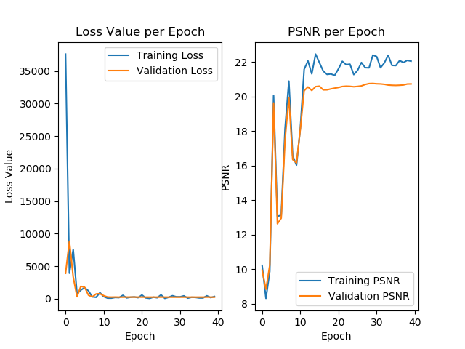
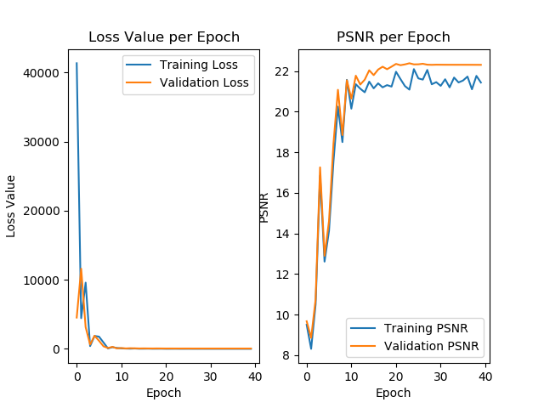
Training Results: Bilateral
Motion Noise
Smoothing Noise

Slide 50
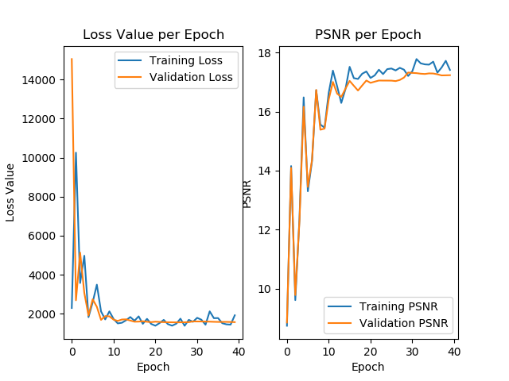
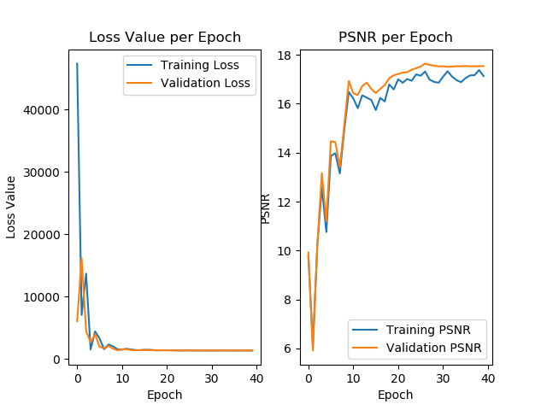
Training Results: Bilateral
Motion Plus White Noise
Smoothing Plus White Noise

Slide 51
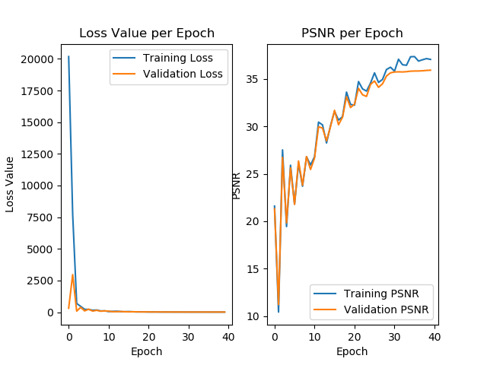
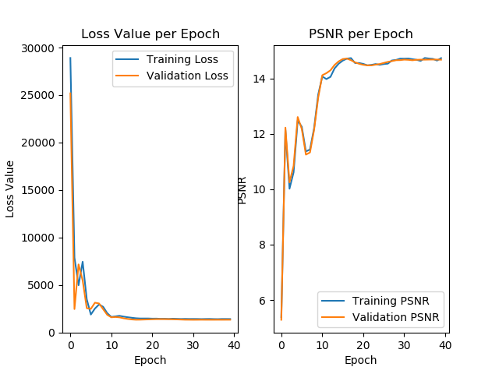
Training Results: Standard CNN
No Noise
Additive Gaussian Noise

Slide 52
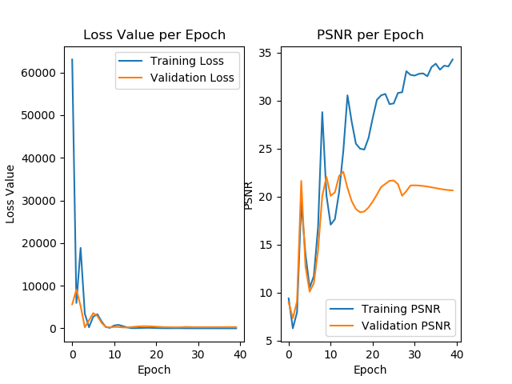
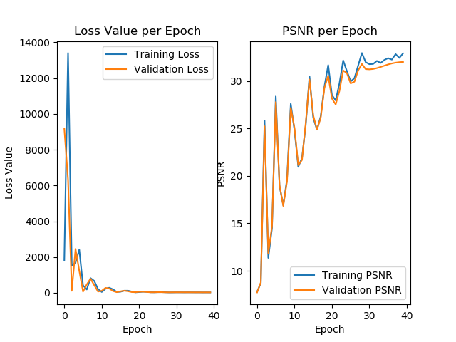
Training Results: Standard CNN
Motion Noise
Smoothing Noise

Slide 53
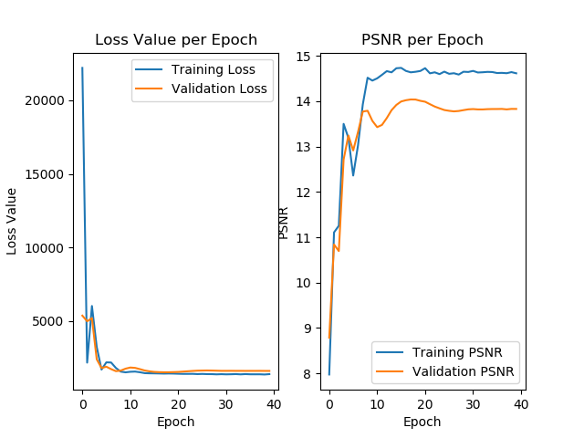

Training Results: Standard CNN
Motion Plus White Noise
Smoothing Plus White Noise

Slide 54
Discussion: Preprocessing Impact on Training
Wavelet Preprocessing: Overall had the best performance across a variety of types of noise. Most notable, when motion noise was present, wavelet preprocessing seemed to address both any high and low frequency components present in each of the LL, LH, HL, and HH. This is because the Wavelet decomposition is designed to address a range of frequencies.
Bilateral Preprocessing: Performed better than the CNN with no preprocessing when noise was inconsistent, or when high frequency components were present, such as in Gaussian White Noise or Motion Blurring.
No Preprocessing: In the presence of high frequency components, consistently performed poorly. When high frequency components were not present, performed very well, better than the other preprocessing methods. This is because it is easier to learn the consistency pattern and filter it out when variability is not present.

Slide 55
Discussion: Noise Impact on Training
No Noise: NOTE: No Noise refers to a very small amount of white noise to avoid an infinite PSNR. Overall, all preprocessing methods trained well in environment. No preprocessing performed best, whereas prefiltering performed the worst. This is because the noise is very small, and subtle inconsistencies are easy to learn.
Gaussian White Noise: Wavelet preprocessing significantly outperformed the other methods. No preprocessing performed poorly. This suggests that the high frequency components associated with Gaussian White Noise are detrimental to the performance when some form of preprocessing is not present.
Motion Noise: Wavelet preprocessing outperformed the other two methods. The other methods performed approximately evenly. This suggests that the wavelet decomposition performs well at addressing both the high and low frequency components of motion blurring, whereas the other two suffer to some extent.

Slide 56
Discussion: Noise Impact on Training
Smoothing Noise: Overall, all preprocessing methods trained well in environment. No preprocessing outperformed the other methods. The smoothing creates an environment of low frequency components, which helps out the No preprocessing environment significantly.
Motion Plus White: The wavelet preprocessing outperformed both methods. No preprocessing performed poorly. Bilateral preprocessing performed moderately. This type of noise has both high frequency and low frequency components that make the wavelet decomposition well equipped to address.
Smoothing Plus White: The wavelet preprocessing outperformed both methods. No preprocessing performed poorly. Bilateral preprocessing performed moderately. This type of noise has both high frequency and low frequency components that make the wavelet decomposition well equipped to address.

Slide 57
Discussion: Preprocessing vs Noise
Each type of preprocessing is designed to address noise prior to training. Overall, the wavelets performed the most consistently well due to the ability to address high frequency and low frequency noise distortion.
Recommendation Based on Training Results: Wavelet Decomposition for Preprocessing

Slide 58
Testing Parameters:
We tested our network against Lena and Cameraman
For Additive Gaussian White Noise
Mean: 0
Std.: 2.0
For Motion Noise/Blurring
Angle from 0: 11
Length: 21
For Gaussian Smoothing Noise
Mean: 0
Std.: 2.0

Slide 59


Testing: Wavelet – No Noise
Noisy Images seem to have a much higher PSNR than the Wavelet CNN Reconstructed.
This is because the original image should have unlimited PSNR, however, nominal noise was added to limit this. This behavior is expected.

Slide 60


Testing: Wavelet – No Noise
Noisy Images seem to have a much higher PSNR than the Wavelet CNN Reconstructed.
This is because the original image should have unlimited PSNR, however, nominal noise was added to limit this. This behavior is expected.

Slide 61

Testing: Wavelet – No Noise
Noisy Images seem to have a much higher PSNR than the Wavelet CNN Reconstructed.
This is because the original image should have unlimited PSNR, however, nominal noise was added to limit this. This behavior is expected.

Slide 62


Testing: Wavelet – No Noise
Noisy Images seem to have a much higher PSNR than the Wavelet CNN Reconstructed.
This is because the original image should have unlimited PSNR, however, nominal noise was added to limit this. This behavior is expected.

Slide 63

Testing: Wavelet – No Noise
Noisy Images seem to have a much higher PSNR than the Wavelet CNN Reconstructed.
This is because the original image should have unlimited PSNR, however, nominal noise was added to limit this. This behavior is expected.

Slide 64


Testing: Wavelet – Additive Noise
The Wavelet Reconstructed images have a much higher PSNR than the original noisy images. This is because of the DWT’s ability to address high frequency components. The reconstructed images are filtered pretty well.

Slide 65

Testing: Wavelet – Additive Noise
The Wavelet Reconstructed images have a much higher PSNR than the original noisy images. This is because of the DWT’s ability to address high frequency components.

Slide 66

Testing: Wavelet – Additive Noise
The Wavelet Reconstructed images have a much higher PSNR than the original noisy images. This is because of the DWT’s ability to address high frequency components.

Slide 67

Testing: Wavelet – Additive Noise
The Wavelet Reconstructed images have a much higher PSNR than the original noisy images. This is because of the DWT’s ability to address high frequency components.

Slide 68

Testing: Wavelet – Additive Noise
The Wavelet Reconstructed images have a much higher PSNR than the original noisy images. This is because of the DWT’s ability to address high frequency components.

Slide 69


Testing: Wavelet – Motion Noise
The Wavelet Reconstructed images have a slightly higher PSNR than the original noisy images. This is because of the DWT’s ability to address the high frequency components. However, in motion noise, there are low frequency components of the noise as well.

Slide 70

Testing: Wavelet – Motion Noise
The Wavelet Reconstructed images have a slightly higher PSNR than the original noisy images. This is because of the DWT’s ability to address the high frequency components. However, in motion noise, there are low frequency components of the noise as well.

Slide 71

Testing: Wavelet – Motion Noise
The Wavelet Reconstructed images have a slightly higher PSNR than the original noisy images. This is because of the DWT’s ability to address the high frequency components. However, in motion noise, there are low frequency components of the noise as well.

Slide 72

Testing: Wavelet – Motion Noise
The Wavelet Reconstructed images have a slightly higher PSNR than the original noisy images. This is because of the DWT’s ability to address the high frequency components. However, in motion noise, there are low frequency components of the noise as well.

Slide 73

Testing: Wavelet – Motion Noise
The Wavelet Reconstructed images have a slightly higher PSNR than the original noisy images. This is because of the DWT’s ability to address the high frequency components. However, in motion noise, there are low frequency components of the noise as well.

Slide 74


Testing: Wavelet – Smoothing
The Wavelet Reconstructed images have a lower PSNR than the original noisy images. This is because Gaussian Smoothing removes the high frequency components that the DWT is best suited for.

Slide 75

Testing: Wavelet – Smoothing
The Wavelet Reconstructed images have a lower PSNR than the original noisy images. This is because Gaussian Smoothing removes the high frequency components that the DWT is best suited for.

Slide 76

Testing: Wavelet – Smoothing
The Wavelet Reconstructed images have a lower PSNR than the original noisy images. This is because Gaussian Smoothing removes the high frequency components that the DWT is best suited for.

Slide 77

Testing: Wavelet – Smoothing
The Wavelet Reconstructed images have a lower PSNR than the original noisy images. This is because Gaussian Smoothing removes the high frequency components that the DWT is best suited for.

Slide 78

Testing: Wavelet – Smoothing
The Wavelet Reconstructed images have a lower PSNR than the original noisy images. This is because Gaussian Smoothing removes the high frequency components that the DWT is best suited for.

Slide 79


Testing: Wavelet – Motion Plus White
The Wavelet Reconstructed images have a higher PSNR than the original noisy images. This is because the Motion Plus White has a variety of high and low frequencies.

Slide 80

Testing: Wavelet – Motion Plus White
The Wavelet Reconstructed images have a higher PSNR than the original noisy images. This is because the Motion Plus White has a variety of high and low frequencies.

Slide 81

Testing: Wavelet – Motion Plus White
The Wavelet Reconstructed images have a higher PSNR than the original noisy images. This is because the Motion Plus White has a variety of high and low frequencies.

Slide 82

Testing: Wavelet – Motion Plus White
The Wavelet Reconstructed images have a higher PSNR than the original noisy images. This is because the Motion Plus White has a variety of high and low frequencies.

Slide 83

Testing: Wavelet – Motion Plus White
The Wavelet Reconstructed images have a higher PSNR than the original noisy images. This is because the Motion Plus White has a variety of high and low frequencies.

Slide 84


Testing: Wavelet – Smoothing Plus White
The Wavelet Reconstructed images have a higher PSNR than the original noisy images. This is because the Smoothing Plus White has a variety of high and low frequencies.

Slide 85

Testing: Wavelet – Smoothing Plus White
The Wavelet Reconstructed images have a higher PSNR than the original noisy images. This is because the Smoothing Plus White has a variety of high and low frequencies.

Slide 86

Testing: Wavelet – Smoothing Plus White
The Wavelet Reconstructed images have a higher PSNR than the original noisy images. This is because the Smoothing Plus White has a variety of high and low frequencies.

Slide 87

Testing: Wavelet – Smoothing Plus White
The Wavelet Reconstructed images have a higher PSNR than the original noisy images. This is because the Smoothing Plus White has a variety of high and low frequencies.

Slide 88

Testing: Wavelet – Smoothing Plus White
The Wavelet Reconstructed images have a higher PSNR than the original noisy images. This is because the Smoothing Plus White has a variety of high and low frequencies.

Slide 89
Wavelet Decomposition: Cameraman Before & After
Cameraman PSNR (dB)
Noise Method | Before | After | Gain
No Noise | 79.95 | 29.86 | (-49.65)
Gaussian White Noise | 14.69 | 19.94 | 5.25
Motion Blur | 17.13 | 18.12 | 0.99
Gaussian Smoothing | 27.56 | 17.90 | (-9.66)
Motion + Gaussian White | 12.63 | 15.91 | 2.47
Smoothing + Gaussian White | 14.42 | 16.61 | 2.19

Slide 90
Wavelet Decomposition: Lena Before & After
Lena PSNR (dB)
Noise Method | Before | After | Gain
No Noise | 80.01 | 33.50 | (-46.51)
Gaussian White Noise | 14.51 | 22.19 | 7.68
Motion Blur | 19.27 | 20.80 | 1.53
Gaussian Smoothing | 34.37 | 20.45 | (-13.92)
Motion + Gaussian White | 13.21 | 17.97 | 4.76
Smoothing + Gaussian White | 14.47 | 18.36 | 3.89

Slide 91
Discussion: Testing – Wavelet Preprocessing
In cases where the noise had low frequency components, the wavelet preprocessing had negative impact.
In cases where the noise had high frequency components, such as in additive white noise, the wavelet preprocessing had a significant improvement in PSNR.
In cases where the noise had a combination of low and high frequency components, such as with motion noise, the wavelet preprocessing had a slight improvement to PSNR.
In the case of No Noise, Wavelet Preprocessing was not significant.
For Additive White Noise, Wavelet Preprocessing performs well.
For Motion Noise, Wavelet Preprocessing gives a slight improvement.
For Gaussian Smoothing Noise, Wavelet Preprocessing has a negative impact.

Slide 92


Testing: Bilateral – No Noise
The Bilateral filter is designed to noise while preserving edges. In the case when No Noise is present, the very high PSNR of the original image outweighs the performance of the prefiltered image.

Slide 93


Testing: Bilateral – Additive Noise
In the case of additive noise, the bilateral prefiltering removes a significant amount of noise and can provide a decent improvement to PSNR.

Slide 94


Testing: Bilateral – Motion Noise
In the case of motion noise, the bilateral prefiltering removes only a slight improvement to PSNR. This is because the motion noise will smooth the edges in one direction.

Slide 95


Testing: Bilateral – Smoothing Noise
In the case of smoothing noise, the bilateral prefiltering degrades the PSNR of the image. This is because the bilateral filter is designed as a edge preserving filter, whereas Gaussian smoothing destroys the edges. This behavior is expected.

Slide 96


Testing: Bilateral – Motion Plus White Noise
In the case of motion plus white noise, the bilateral filter operates more effectively. It is effective at removing Gaussian white noise. Therefore, the improvement to PSNR is strong.

Slide 97


Testing: Bilateral – Smoothing Plus White Noise
In the case of smoothing plus white noise, the bilateral filter operates more effectively. It is effective at removing Gaussian white noise. Therefore, the improvement to PSNR is strong.

Slide 98
Bilateral Prefiltering: Cameraman Before & After
Cameraman PSNR (dB)
Noise Method | Before | After | Gain
No Noise | 79.98 | 18.94 | (-61.04)
Gaussian White Noise | 14.75 | 16.39 | 1.64
Motion Blur | 17.13 | 17.74 | 0.61
Gaussian Smoothing | 27.56 | 19.86 | (-7.70)
Motion + Gaussian White | 12.65 | 15.55 | 2.90
Smoothing + Gaussian White | 14.47 | 16.47 | 2.00

Slide 99
Bilateral Prefiltering: Lena Before & After
Lena PSNR (dB)
Noise Method | Before | After | Gain
No Noise | 79.98 | 23.68 | (-56.30)
Gaussian White Noise | 14.50 | 18.38 | 3.88
Motion Blur | 19.27 | 20.97 | 1.70
Gaussian Smoothing | 34.37 | 24.69 | (-9.68)
Motion + Gaussian White | 13.21 | 17.27 | 4.06
Smoothing + Gaussian White | 14.43 | 18.10 | 3.67

Slide 100
Discussion: Testing – Bilateral Prefiltering
The Bilateral Filter is an edge preserving filter.
In cases where an edge was more prevalent, the Bilateral Prefiltering provided an decent improvement to PSNR.
Gaussian White Noise Only
Smoothing Plus Gaussian White Noise
Motion Plus Gaussian White Noise
In cases where the edges were smoothed out, the Bilateral Prefiltering had negligible or negative impact to PSNR.
Motion Blur (Negligible improvement)
Gaussian Smoothing (Negative impact)
The reason for this behavior is because in cases with Gaussian White Noise, edge characteristics are still present, even when it is combined with smoothing effects. However, with smoothing effects alone, the edges are destroyed.

Slide 101


Testing: No Prefiltering CNN – No Noise
With No Prefiltering, the performance of the network alone is exposed. In the case of No Noise, the CNN performed the best on the final filtered image. This is because it was able to directly learn the nominal noise characteristics.

Slide 102


Testing: No Prefiltering CNN – Additive Noise
In the case of additive noise, the CNN with no prefiltering did not improve PSNR. This is because the noise impact was too significant.

Slide 103


Testing: No Prefiltering CNN – Motion Noise
In the case of motion noise, the CNN with no prefiltering did not improve PSNR. This is because the noise impact was too significant.

Slide 104


Testing: No Prefiltering CNN – Smoothing Noise
In the case of smoothing noise, the CNN with no prefiltering did not improve PSNR. This is because the noise impact was too significant.

Slide 105


Testing: No Prefiltering CNN – Motion Plus White Noise
In the case of motion plus white noise, the CNN with no prefiltering did not improve PSNR. This is because the noise impact was too significant.

Slide 106


Testing: No Prefiltering CNN – Smoothing Plus White Noise
In the case of smoothing plus white noise, the CNN with no prefiltering did not improve PSNR. This is because the noise impact was too significant.

Slide 107
No Prefiltering: Cameraman Before & After
Cameraman PSNR (dB)
Noise Method | Before | After | Gain
No Noise | 80.04 | 32.40 | (-47.64)
Gaussian White Noise | 14.73 | 14.65 | (-0.08)
Motion Blur | 17.13 | 17.08 | (-0.05)
Gaussian Smoothing | 27.56 | 26.02 | (-1.54)
Motion + Gaussian White | 12.62 | 12.56 | (-0.06)
Smoothing + Gaussian White | 14.47 | 14.00 | (-0.47)

Slide 108
No Prefiltering: Lena Before & After
Lena PSNR (dB)
Noise Method | Before | After | Gain
No Noise | 80.00 | 37.96 | (-42.04)
Gaussian White Noise | 14.49 | 14.46 | (-0.03)
Motion Blur | 19.27 | 19.21 | (-0.06)
Gaussian Smoothing | 34.37 | 32.12 | (-2.25)
Motion + Gaussian White | 13.23 | 13.18 | (-0.05)
Smoothing + Gaussian White | 14.46 | 14.02 | (-0.44)

Slide 109
Discussion: Testing – No Prefiltering CNN
In all cases, when a network was trained with no prefiltering, the PSNR was not improved.
This suggests several items:
The network depth needs to be increased in increase the learning capacity.
The added noise characteristics were to significant to be learned by a CNN with no prefiltering
Suggestions for improvement:
Increase the depth of the network
Prefilter the images

Slide 110


Testing: Wiener Filter – No Noise
With Wiener Filtering, the no-noise filtered image was somewhat smoothed out. This is because the Wiener Filter is designed to smooth out the noise in the images.

Slide 111


Testing: Wiener Filter – Additive Noise
With Wiener Filtering, the filtered image with white noise had a significant improvement to PSNR. This suggests the Wiener Filter is effective at removing additive white noise.

Slide 112


Testing: Wiener Filter – Motion Noise
With Wiener Filtering, there was not an effective improvement to PSNR when motion blur was present. This suggests that the blur was too significant.

Slide 113


Testing: Wiener Filter – Smoothing Noise
With Wiener Filtering, there was a negative impact to PSNR when Gaussian smoothing blur was present. This suggests that the filter is not effective for this type of blur.

Slide 114


Testing: Wiener Filter – Motion Plus White Noise
With Wiener Filtering, there was a decent improvement to PSNR when motion blur plus additive white noise was present. Based on previous observations, this suggests that the filter is effective for removing the white noise portion of the noise.

Slide 115


Testing: Wiener Filter – Smoothing Plus White Noise
With Wiener Filtering, there was a decent improvement to PSNR when Gaussian smoothing blur plus additive white noise was present. Based on previous observations, this suggests that the filter is effective for removing the white noise portion of the noise.

Slide 116
Wiener Filter: Cameraman Before & After
Cameraman PSNR (dB)
Noise Method | Before | After | Gain
No Noise | 80.03 | 21.34 | (-58.69)
Gaussian White Noise | 14.69 | 20.64 | 5.95
Motion Blur | 17.13 | 17.07 | (-0.06)
Gaussian Smoothing | 27.56 | 21.23 | (-6.33)
Motion + Gaussian White | 12.58 | 16.81 | 4.23
Smoothing + Gaussian White | 14.47 | 20.58 | 6.11

Slide 117
Wiener Filter: Lena Before & After
Lena PSNR (dB)
Noise Method | Before | After | Gain
No Noise | 80.00 | 26.10 | (-53.93)
Gaussian White Noise | 14.52 | 25.09 | 10.57
Motion Blur | 19.27 | 19.27 | 0.00
Gaussian Smoothing | 34.37 | 25.97 | (-8.40)
Motion + Gaussian White | 13.20 | 19.06 | 5.86
Smoothing + Gaussian White | 14.46 | 25.02 | 10.56

Slide 118
Discussion: Testing – Wiener Filtering
The Wiener filter appears to be effective at removing additive Gaussian white noise. In all cases with white noise, the PSNR was improved.
Compared to the CNN methods:
The Wiener Filter performs better than the standard CNN and the Bilateral Preprocessing.
The Wiener Filter performed as well as the wavelet decomposition.
The Wiener Filter performed well on Gaussian additive noise images.
Suggestions for improvement:
Rely on a version of CNN and increase the depth of the network and the number of channels
Prefilter the images

Slide 119
Side-by-Side Comparison: Cameraman
Cameraman: Final PSNR (dB)
Noise Method | Wavelet Decomposition CNN | Bilateral Prefiltering CNN | No Prefiltering CNN | Wiener Filter
No Noise | 29.86 | 18.94 | 32.40 | 21.34
Gaussian White Noise | 19.94 | 16.39 | 14.65 | 20.64
Motion Blur | 18.12 | 17.74 | 17.08 | 17.07
Gaussian Smoothing | 17.90 | 19.86 | 26.02 | 21.23
Motion + Gaussian White | 15.91 | 15.55 | 12.56 | 16.81
Smoothing + Gaussian White | 16.61 | 16.47 | 14.00 | 20.58
On Average, for grayscale images, the Wavelet Decomposition Preprocessing, Bilateral
Prefiltering performed comparably, while the Wiener Filter performed slightly better for
Final PSNR. When no prefiltering was used, the performance was generally worse.

Slide 120
Side-by-Side Comparison: Cameraman
Cameraman: PSNR Gain (dB)
Noise Method | Wavelet Decomposition CNN | Bilateral Prefiltering CNN | No Prefiltering CNN | Wiener Filter
No Noise | (-49.65) | (-61.04) | (-47.64) | (-58.69)
Gaussian White Noise | 5.25 | 1.64 | (-0.08) | 5.95
Motion Blur | 0.99 | 0.61 | (-0.05) | (-0.06)
Gaussian Smoothing | (-9.66) | (-7.70) | (-1.54) | (-6.33)
Motion + Gaussian White | 2.47 | 2.90 | (-0.06) | 4.23
Smoothing + Gaussian White | 2.19 | 2.00 | (-0.47) | 6.11
On Average, for grayscale images, the Wavelet Decomposition Preprocessing, Bilateral
Prefiltering performed comparably, while the Wiener Filter performed slightly better for
Final PSNR. When no prefiltering was used, the performance was generally worse.

Slide 121
Side-by-Side Comparison: Lena
Cameraman: Final PSNR (dB)
Noise Method | Wavelet Decomposition CNN | Bilateral Prefiltering CNN | No Prefiltering CNN | Wiener Filter
No Noise | 33.50 | 23.68 | 37.96 | 26.10
Gaussian White Noise | 22.19 | 18.38 | 14.46 | 25.09
Motion Blur | 20.80 | 20.97 | 19.21 | 19.27
Gaussian Smoothing | 20.45 | 24.69 | 32.12 | 25.97
Motion + Gaussian White | 17.97 | 17.27 | 13.18 | 19.06
Smoothing + Gaussian White | 18.36 | 18.10 | 14.02 | 25.02
On Average, for grayscale images, the Wavelet Decomposition Preprocessing, Bilateral
Prefiltering performed comparably, while the Wiener Filter performed slightly better for
Final PSNR. When no prefiltering was used, the performance was generally worse.

Slide 122
Side-by-Side Comparison: Lena
Cameraman: PSNR Gain (dB)
Noise Method | Wavelet Decomposition CNN | Bilateral Prefiltering CNN | No Prefiltering CNN | Wiener Filter
No Noise | (-46.51) | (-56.30) | (-42.04) | (-53.93)
Gaussian White Noise | 7.68 | 3.88 | (-0.03) | 10.57
Motion Blur | 1.53 | 1.70 | (-0.06) | 0.00
Gaussian Smoothing | (-13.92) | (-9.68) | (-2.25) | (-8.40)
Motion + Gaussian White | 4.76 | 4.06 | (-0.05) | 5.86
Smoothing + Gaussian White | 3.89 | 3.67 | (-0.44) | 10.56
On Average, for grayscale images, the Wavelet Decomposition Preprocessing, Bilateral
Prefiltering performed comparably, while the Wiener Filter performed slightly better for
Final PSNR. When no prefiltering was used, the performance was generally worse.

Slide 123
Conclusion
For grayscale images, the Wavelet Decomposition Preprocessing and Bilateral Prefiltering performed comparably.
The Wiener Filter performed slightly better.
When no prefiltering was used, the performance was generally worse.
This is not our final conclusion since Homework 4 revealed that all CNN Methods
Outperformed the Wiener Filter for RGB images.

Slide 124
Next Steps
For the next steps in this research, the following is proposed:
Perform an identical experiment for color images.
Increase the depth of the Convolutional Neural Network.
Change the design of the Convolutional Neural Network

